Slide 1

ADHIPARASAKTHI COLLEGE OF ENGINEERING
G.B. NAGAR, KALAVAI, RANIPET DIST - 632 516.
Batch : 12
PROJECT FINAL REVIEW
AI-Powered Text Analyzer
Summarization | Emotion Detection |Title Generation
GUIDED BY :
TEAM MEMBERS :
Mr.B.Sukkrivan,M.Tech,(Ph.D)
SURYA S (510121104047)
VIGNESH S (510121104053)
SUDHARSAN V (510121104043)
SIDDIQ S (510121104039)

Slide 2
Project Abstract
The AI-Powered Text Analyzer is an advanced NLP system designed to enhance text interpretation using transformer-based models. The application performs three primary tasks: summarization (BART), emotion detection (DistilBERTa), and title generation (T5).
A key improvement includes a refined title generator that intelligently extracts the best two keywords, delivering concise, relevant titles instead of echoing summaries.
The system is deployed with a Streamlit interface, supporting real-time interaction, and is suited for applications like article summarization, sentiment analysis, and content creation.

Slide 3


Problem Statement
Manual Tasks
Summarization and title writing are slow and error-prone.
Tool Limitations
Lack integration, emotional depth, and ease of use.

Slide 4
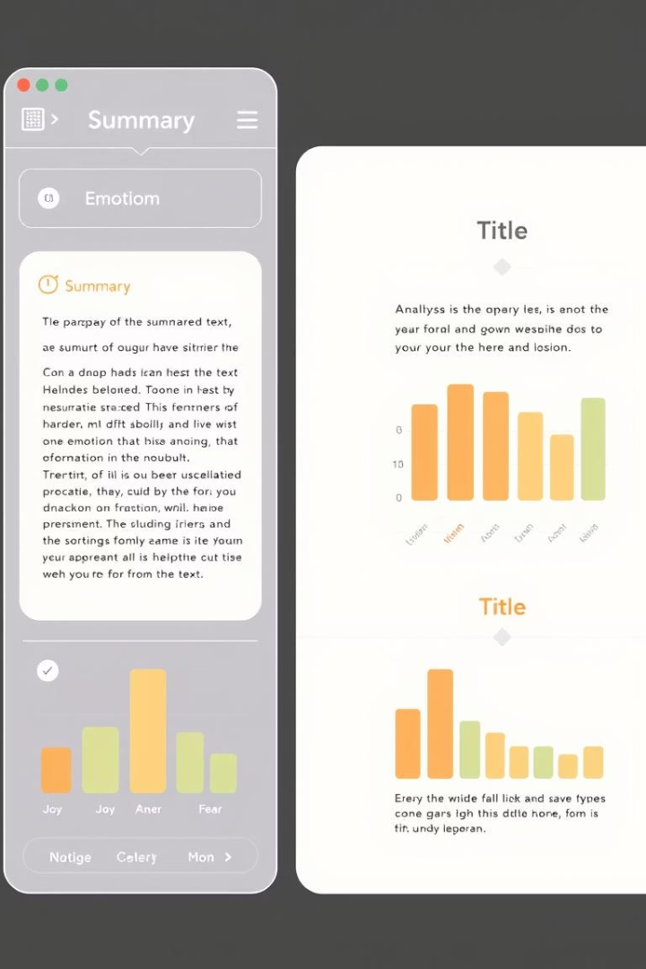
Project Objectives
Summarize Content
Leverage BART model for precise text summarization
Emotion Detection
Use DistilRoBERTa to classify emotional tones accurately
Title Generation
Apply T5 model to create concise, relevant titles
User Interface
Develop an intuitive UI using Streamlit framework

Slide 5

Literature Survey
Transformer architectures: BERT, RoBERTa, GPT
Sentiment lexicons and word embeddings
Pretrained datasets: Kaggle, Semeval challenges

Slide 6





Existing Systems
Manual Summarization
Labor-intensive and inconsistent
No Emotion Insight
Lack of emotional context in outputs
No Integration
Separate tools for tasks create workflow gaps
No Title Generation
Titles must be manually created

Slide 7
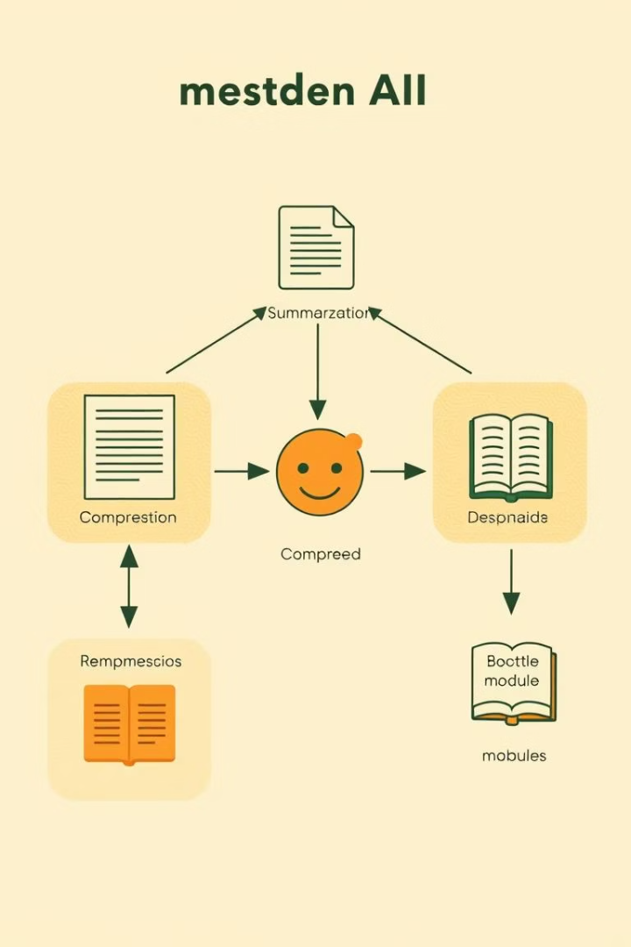
Proposed System
Summarization
Uses BART model for accurate summaries.
Emotion Detection
DistilRoBERTa identifies emotional tone.
Title Generation
T5 model creates concise titles.
Integration
All features combined in Streamlit UI.

Slide 8
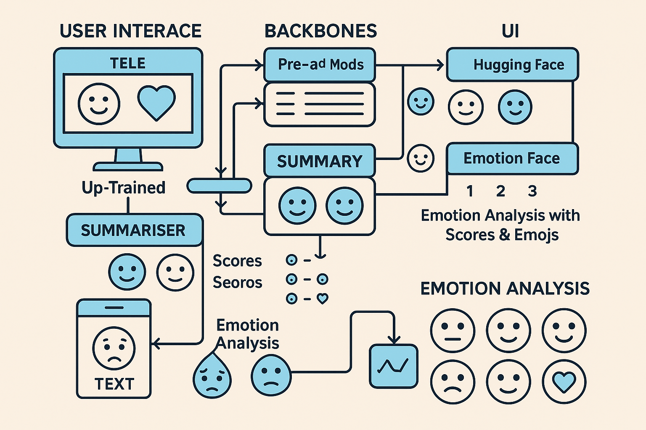
System Architecture
1
User Input
Text entered by user for analysis.
2
Preprocessing
Text cleaned and prepared for models.
3
BART Summary
Generates text summary.
4
RoBERTa Emotion
Detects emotional tone.
5
T5 Title
Creates a short title.
6
UI Display
Shows results to user.

Slide 9

Module 1: Input Handling
Preprocessing
Word Limit
Convert text to lowercase.
Restrict input to 750 words.
Trigger
Analyze starts on user command.

Slide 10
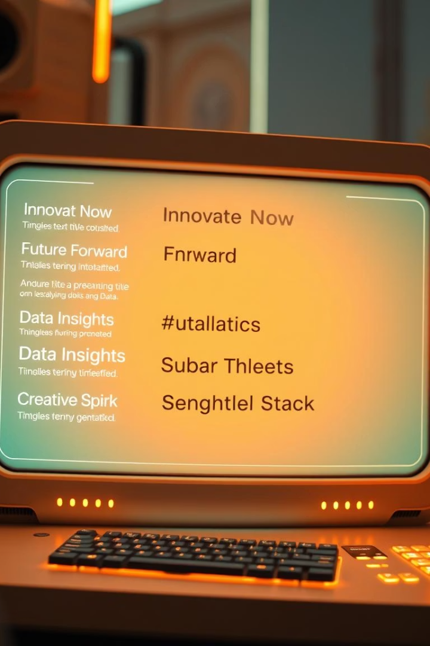
Module 2: Title Generation
Model Used
Input
T5 transformer model.
Summarization prompt text.
Output
Titles of 2 to 5 words.

Slide 11
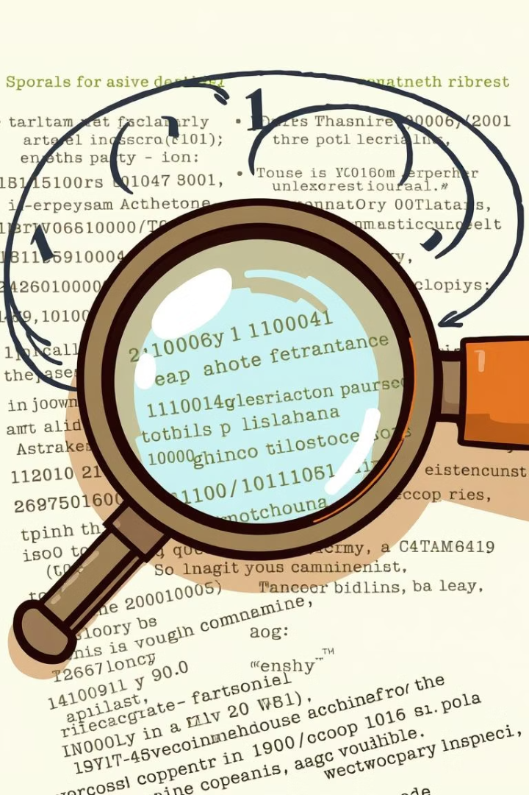
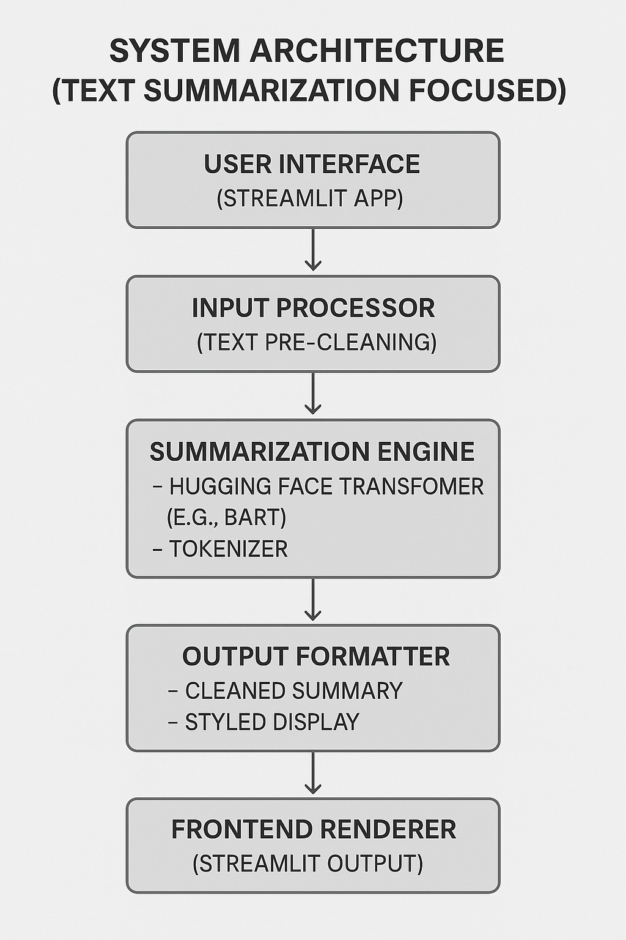
Module 3 – Summarization
Model
BART-large transformer for abstractive summarization.
Function
Produces concise and clear summaries.

Slide 12
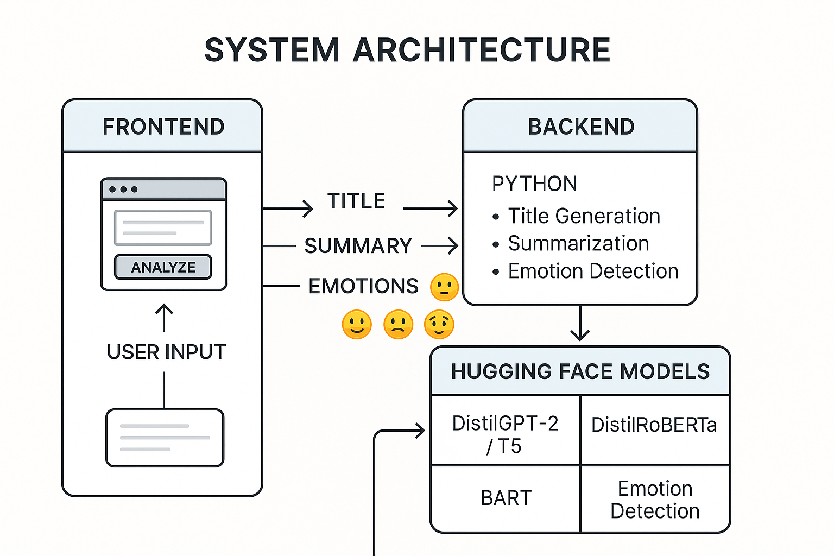
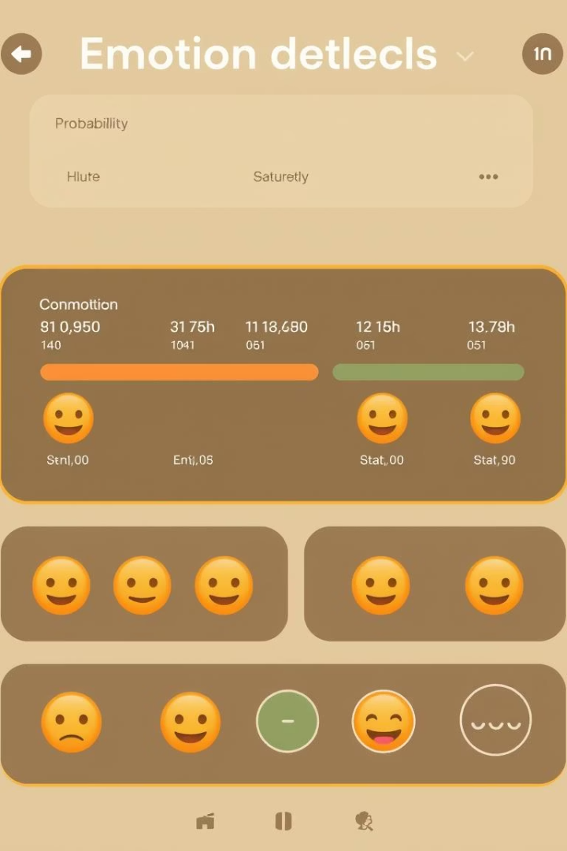
Module 4 – Emotion Detection
Model
DistilRoBERTa transformer detects emotions.
Output
Shows top 3 emotions with emojis.

Slide 13
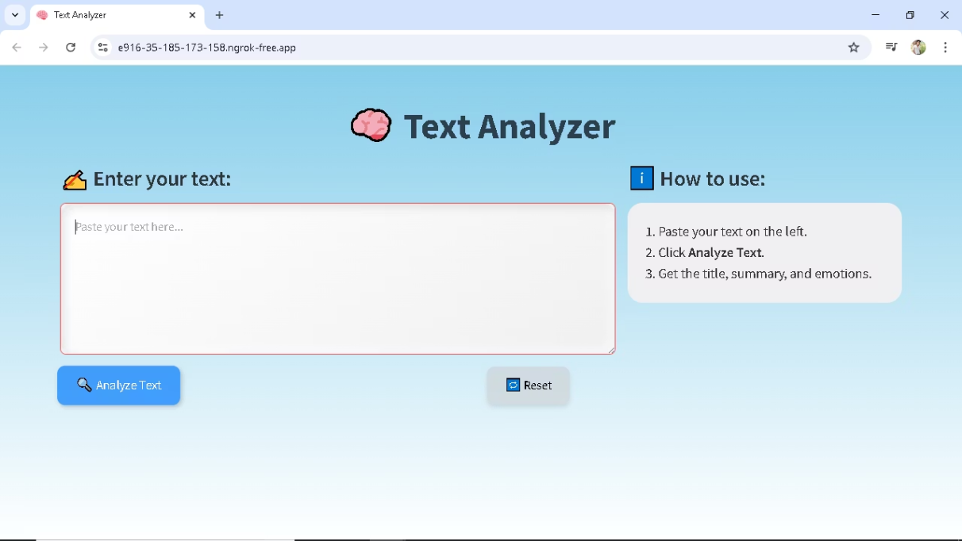
Streamlit UI Design
The UI integrates all modules in a clean, user-friendly interface.
Designed for easy input and clear output display.

Slide 14
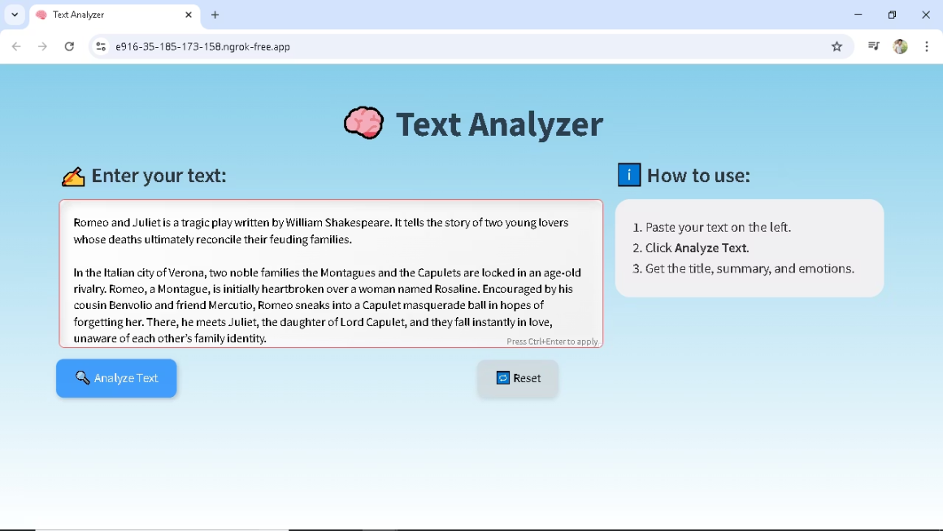
Output Screenshot 1: Input Given
Example input text is entered for processing.
The system accepts summarization prompts seamlessly.

Slide 15
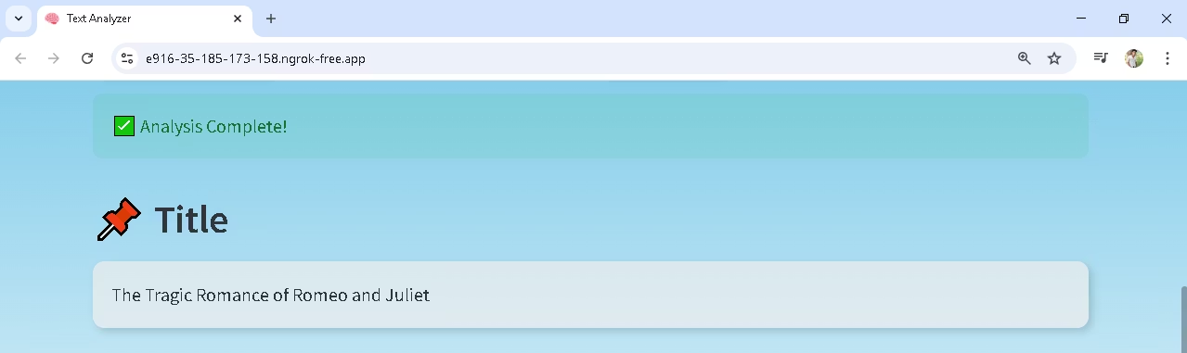
Output Screenshot 2 : Title Generating
Generated titles are concise and relevant.

Slide 16
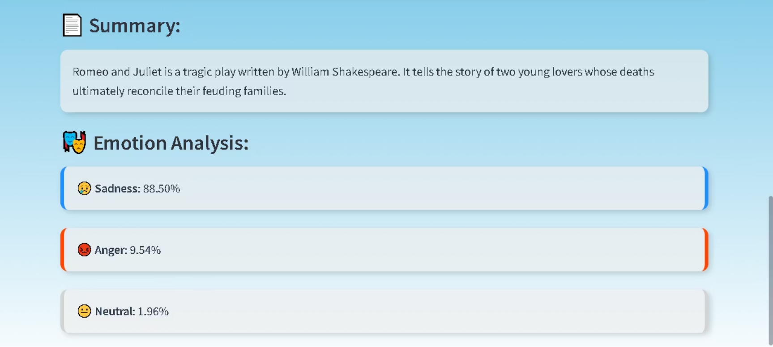
Output Screenshot 3:Summary & Emotion
Summaries and emotion detection results are clearly displayed.

Slide 17

Conclusion & Future Scope
Achievements
Integrated transformer models for summarization, title, and emotion.
Future Plans
Add voice input, support larger inputs, and deploy publicly.
Multilingual support
File upload

